Slide 1
Inheritance Basics
You should be able to:
Define the term ‘inheritance’ as used in Java, and name the keyword that implements inheritance
Distinguish between subclass and superclass
Write subclasses which extend existing classes
Define the term ‘method overriding’ in OOP, give an example of when it might be needed and override superclass methods within a subclass
Invoke superclass methods within a subclass where appropriate
Show ‘is-a’ inheritance relationships in a VOPC diagram
Illustrate a hierarchy of classes as a tree, and write class headers for the classes in the hierarchy
Explain the role of the ‘protected’ visibility modifier
Slide <number>
Notes:
OOP3Slides1: Units 1 to 4

Slide 2
Sample Programs
Student.java
StudentTest.java
Person.java
Player.java
Slide <number>
Notes:
OOP3Slides1: Units 1 to 4

Slide 3
Review: core OO principles
Encapsulation … private attributes, public methods, packaged into one entity
Modularity … system divided into units called classes. Classes further divided into methods. Methods perform one task only.
Code Re-use … aggregation, utility classes
Extensibility
Slide <number>

Slide 4
Extensibility
OOP provides Encapsulation + Extensibility
Encapsulation: permits code to be used without knowing implementation details
Extensibility: permits behavior of classes to be changed or extended without having to rewrite the code of the class
Mechanism for extensibility in OO-programming
Inheritance
Slide <number>

Slide 5
Inheritance is a form of software reuse
New classes are created from existing classes via the keyword ‘extends’.
The new class (called the derived class or subclass)
  takes on board all the attributes and methods (but not constructors) of the existing class (called the base class or superclass)
  adds its own attributes and methods
  provides its own version of some of the superclass methods by overriding them
Classes in Java are usually organised into hierarchies.
Slide <number>

Slide 6
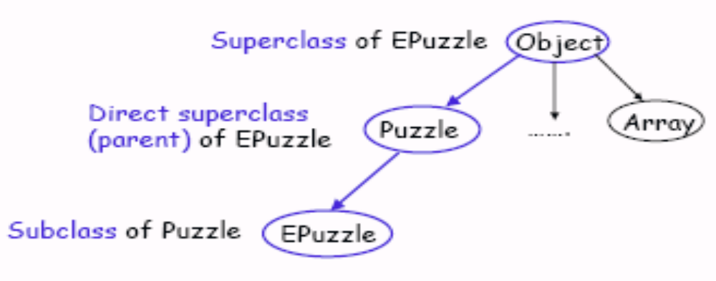
Class Hierarchy Example
Every class (except Object) has a unique direct superclass, called its parent class
Exercise: write headers for Puzzle and EPuzzle
Slide <number>

Slide 7
Java only allows Single Inheritance
Every class is implicitly a subclass of Object
A class can extend exactly one other class
public class Puzzle {…}
  This class implicitly extends Object
public class EPuzzle extends Puzzle {…}
  This class explicitly extends Puzzle, and implicitly extends Object since Puzzle is a subclass of Object
Class hierarchy in Java is a tree
In other OO languages, such as C++, a class can have more than one superclass (multiple inheritance): not in Java
Slide <number>

Slide 8
Quick Check
What keyword is used to implement inheritance?
Is the new class (the one that inherits) known as the superclass or the subclass?
How many superclasses can a Java class have?
What is the superclass of the Java API class JComponent?
Name two subclasses of JComponent
Slide <number>

Slide 9
When to use Inheritance?
In terms of writing code, it can be difficult to know exactly when one should and can utilise inheritance.
Normally, the opportunity exists when you can identify a situation where you have 2 entities where an “is-a” relationship exists e.g. a Student is a Person,a Car is a Vehicle, a FacultyMember is an Employee. Student, Car and FacultyMember would be subclasses.
Slide <number>

Slide 10
Sample class Person
public class Person{
  private String name;
  private int age;
  private char gender;
  // all the usual methods
}
Slide <number>

Slide 11
“Is-a” Relationships via Inheritance: Student
Suppose you want a class to model a Student.
A Student will have name, gender and age: these are the attributes of a Person
A Student ‘is a’ Person.
Students will have other attributes: student number and course.
You can re-use the attributes of the Person class by means of inheritance
Slide <number>

Slide 12
To create the Student class
Include the clause ‘extends Person’ in the class header
Declare the new attributes (course and student number)
Write ‘get’ and ‘set’ methods for the new attributes
Write a 5-args constructor which passes the 3 Person values up to the Person 3-args constructor and sets the other two itself
Write a no-args constructor, if needed (this one will invoke the Person no-args constructor by default)
Override the Person toString() method so that all the attributes of a Student are displayed. It is possible to incorporate the Person toString() by using ‘super’.
Slide <number>

Slide 13
Class Header for Student, and no-args constructor
public class Student extends Person{
private String studentNumber;
private String course;
public Student()
{
setStudentNumber(“Unassigned");
setCourse(“Unknown");
}
Note that the Person constructor
will be called automatically here
Slide <number>

Slide 14
The extends keyword allows inheritance to occur in Java. It must come after the subclass name in the class definition, followed by the name of the superclass.
public class Student extends Person {
The constructor with arguments contains the following important code to pass the relevant arguments it receives “up” to the superclass constructor. ‘super’ is the keyword which refers to the superclass (Person in this case)
super(name,age,gender);
Slide <number>

Slide 15
Order of the parameters to the constructor
The parameters to the Student constructor should be ordered in the most convenient way for the user
The order of the arguments passed to the superclass constructor within the Student constructor must match the order within the corresponding Person constructor
The call to the superclass constructor must be the first action within the subclass constructor
Slide <number>

Slide 16
Multi-args constructor and ‘get’ methods for the new attributes
public Student (String snum, String c, String nm, int a, char g){
super(nm,a,g);
setStudentNumber(snum);
setCourse(c);
}
public String getStudentNumber() {
return studentNumber; }
public String getCourse() { return course;}
This refers to the superclass i.e. Person
Slide <number>

Slide 17
Exercise
Rewrite the Student 5-args constructor so that it allows the user to create students and supply the arguments in the order:
name, t-number, course, age, gender
Can this version co-exist with the other version?
Slide <number>

Slide 18
Mutator methods
public void setStudentNumber(String snum) {
studentNumber = snum;
}
public void setCourse(String c) {
course = c;
}
No mutator needed for age, gender or name: why not?
Slide <number>

Slide 19
toString() method for Student: overrides inherited toString()
public String toString() {
return "Student Number is " +
getStudentNumber() + "\n" +
"Course is " + getCourse() + "\n" +
"Student name is " + getName() + "\n" +
"Student age is " + getAge() + "\n" +
“Gender is " + getGender() ;
}
}
Nb there is another way, which incorporates toString() from Person
Slide <number>

Slide 20
Overriding
When a subclass is created it will automatically inherits all the attributes and public methods of its superclass. (differentiate between inherit and accessing attributes)
The subclass may inherit a method it needs, but should implement differently
Overriding is the process by which a programmer can redefine a method in a subclass, giving it an appropriate implementation
Slide <number>

Slide 21
Overriding
A method declaration m in subclass B overrides a method m in superclass A if
  Both methods have the same name,
  Both are class methods or both are instance methods, and
  Both have the same number and type of parameters and same return type
Example: clone() in Weight overrides clone() from Object
Slide <number>

Slide 22
Final methods
A method can be declared as ‘final’: in this case it cannot be overridden in a subclass
The Object class has final methods wait() and notify(): these are very technical and it would not be appropriate for any other class to override them
Exercise: try to do it
Slide <number>

Slide 23
Overriding toString()
Student inherits the toString() method of its Person superclass.
This definition of toString() is useless to the Student class as it only gives attributes defined for a Person and includes no reference to the Student attributes.
Student must override the Person toString() with its own more appropriate definition of it.
Slide <number>

Slide 24
Alternative toString(), which invokes the superclass toString():
When a subclass overrides a superclass method, the subclass can still refer to the non-private superclass method via the super keyword e.g.
public String toString() {
return "Student Number:" +
getStudentNumber() + "\n" +
"Course: " + getCourse() + "\n" +
“Personal Details " + super.toString();
}
Slide <number>

Slide 25
Something new: ‘protected’ attributes
The first part of the toString() method could have been written like this, without using the access methods.
return "Student Number is " + studentNumber + "\n" + "Course is " + course + "\n“
It would not have been possible to continue with
+ “Name “ + name;
because name is declared private in Person. The subclass can only access it via the ‘get’ method.
This is usually all the subclass needs: but it is possible to grant access to subclasses by using the visibility modifier ‘protected’ instead of ‘private’.
Slide <number>

Slide 26
Person class with protected attributes
public class Person{ // revised
  protected String name;
  protected int age;
  protected char gender;
Anything declared as protected is accessible to subclasses, and to all other classes within the same package
It is not a ‘safe’ process, as other classes within the same package can gain access to the internal data of a class
It should only be used when strictly necessary
Slide <number>

Slide 27
Testing plan for Student
Create a default student object, and display its details (tests the constructor and toString())
Student s1 = new Student();
JOP.smD(null, “S1: “ + s1);
Create a student object with known details
Student s2 = new Student(“t123”,
“AgEng3”, “Joe Soap”, 21, ‘m’);
Check that the ‘get’ methods from Person work on it (display the course name, the student’s name and the student’s age)
JOP.smD(null,s2.getCourse() + “ “ +
s2.getName()+ “ “ + s2.getAge());
Slide <number>

Slide 28
Testing plan for Student, more
Check that the ‘set’ methods from Person work on it (change the age and the course name): redo the previous display
s2.setAge(40);
s2.setCourse(“Ag Eng 4”);
Check that toString() is working correctly by displaying the full details of this student
Slide <number>

Slide 29
Showing ‘is-a’ relationships in VOPC diagrams
An ‘is a’ relationship (inheritance) between classes is indicated by solid line ending in an closed unfilled arrow from the subclass to the superclass
Note that a ‘uses’ relationship between classes is shown by a solid line ending in a closed filled arrow
Slide <number>

Slide 30
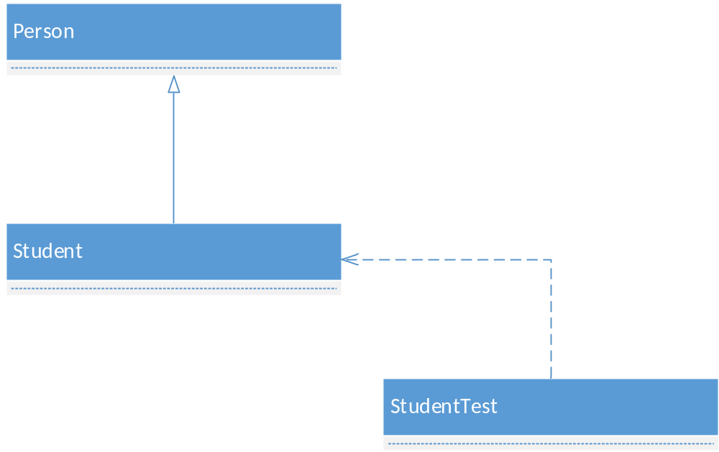
partial VOPC diagram for StudentTest
Slide <number>

Slide 31
Desk Exercise
The Player class has attributes name and score. Write a subclass PacmanPlayer which also has an attribute ‘lives’ representing the number of lives left for the player. This should initially be 3 for all players. Include methods loseALife() and isDead().
Slide <number>

Slide 32
Review: boolean type
In the PacmanPlayer class
int lives;
public boolean isDead() {
return lives > 0 ? false : true;
}
In the tester
PacmanPlayer p = new PacmanPlayer(“Joe”, 10);
p.loseALife(); p.loseALife();
if (p.isDead())
JOP.smD(null, “Player Dead”);
else
JOP.smD(null, “Player Still Alive”);
Slide <number>

Slide 33
Review: ?: ternary operator in Java
part 1 ? part 2 : part 3
Where a 3-part ?: expression is embedded in a line of java code
part 1 is tested: (it must evaluate to boolean)
If true, whole expression replaced by part 2
If false, whole expression replaced by part 3
Parts 2 and 3 must be of a type compatible with the rest of the line of code
Slide <number>

Slide 34
Example, ?:
public boolean isDead() {
return lives>0 ? false : true;
}
Part 1: lives > 0 (this will be true or false)
Part 2: false Part 3: true
Parts 2 and 3 are boolean, compatible with the method header which declares the method to be boolean, thus what it returns must be boolean
In many situations, Parts 2 and 3 will be Strings
Slide <number>

Slide 35
Review: boolean attributes
boolean alive; // ‘false = dead’
access methods for booleans typically start with ‘is’ rather than ‘get’
public boolean isAlive() {
return alive; }
Note: in this case, you do not need a second attribute boolean dead;
Slide <number>

Slide 36
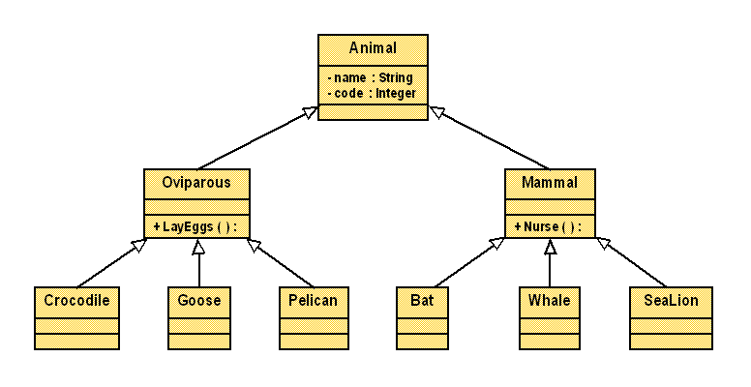
Class Hierarchies
Hierarchies of classes are usually shown as a tree, with the most general class at the top.
Exercise: write an appropriate header for each of these classes
Slide <number>

Slide 37
Generalisation and Customisation via Inheritance
In the OO Design process, the designer looks for commonality among a set of classes and takes out the features in common for inclusion in potential superclasses.
These superclasses are called generalisations of their subclasses.
Subclasses can be customised based on these superclasses, ultimately creating less complex individual classes and promoting software reuse.
Slide <number>

Slide 38
Desk Exercise
Organise the following classes into a hierarchy :
Student, Professor, Object, TeachingAssistant, Secretary, Employee, Person, Course, Seminar, Lecture, ComputerLab, SeminarSpeaker, ComputerPractical
Slide <number>

